Slide 1

CSE/DSC 234 — Project 1
RAG & Context Engineering + RapidFire AI OSS
Spring 2026

Slide 2
Outline
1
Part 1 (Course project overview – ~14 min + DataHub setup – ~3 min)
2
Part 2 (RapidFire AI OSS ~14 min + RAG with RapidFire AI~5 min)
3
Submission logistics – ~4 min
4
Live Demo – ~10-15 mins

Slide 3
Part I: Course Project Overview

Slide 4
Learning outcomes
Build an end-to-end RAG pipeline: chunking, embedding, indexing, retrieval, reranking, generation
Create ≥20 golden Q&A pairs with source locations (data curation)
Apply retrieval + generation metrics; LLM-as-judge; optional custom metrics
Use RapidFire AI OSS for systematic multi-config experiments
Develop judgment on retrieval/context tradeoffs for real applications

Slide 5
High-level task
Single-turn Q&A over the RapidFire AI OSS documentation corpus
Use RapidFire’s multi-config framework to explore and optimize the pipeline
Hard constraint: ≤2,000 tokens per query to the LLM (system + all context)
Models production: corpora are huge vs. context window - retrieval engineering matters

Slide 6
3 main things for you to do
1. Golden data: ≥20 hand-labeled Q&A pairs with identified source locations
2. System: RAG that retrieves relevant chunks and answers within the budget
3. Experimentation: compare multiple configs (chunking, embedding, retrieval, rerank, prompts)

Slide 7
Infrastructure
Compute: DSMLP DataHub 8-core + 32 GB RAM machine
LLM APIs: Triton API Gateway
Framework: pip install rapidfireai; run_evals() API for multi-config RAG evaluation
RAG: LangChain via RFLangChainRagSpec
Embeddings: OpenAI or CPU OSS (e.g. sentence-transformers, BGE)

Slide 8
Vector stores & retrievers
FAISS (default): in-memory, Create mode - quick start
PGVector / Pinecone: persistent; Read/Update —> embed once, many retrieval configs
Any LangChain BaseRetriever: BM25, hybrid, ensemble, custom
Built-in: similarity / score threshold / MMR, top-k —> all experiment knobs
Optional cross-encoder reranking (e.g. CrossEncoderReranker)

Slide 9
Release packet & evaluation
Starter setup, doc corpus (RST plaintext), 20 Q&A pairs released val set
Retrieval script: F1, Precision@k, Recall@k vs. ground-truth spans
LLM judge (0–5): Correctness, Completeness, Faithfulness
Hidden test + two hidden judge metrics; leaderboard formula combines retrieval & generation

Slide 10
Leaderboard score (summary)
Overall = 0.5 × Retrieval + 0.5 × Generation
Retrieval = average of F1 + Precision@5 + Recall@5
Generation = average of five 0–5 judge scores (incl. two hidden)
Leaderboard is for extra credit only (top 10th and 20th percentiles)

Slide 11
Deliverables you must produce
≥20 golden Q&A JSON (quality, diversity: factual, conceptual, procedural, comparative)
main.py: python3 main.py --input … --output … (deterministic final pipeline)
Output JSON: question_id, answer, sources (tuples per spec)
Report: pipeline, methodology (≥8 distinct configs), results, AI tools statement
Private git repo + logs/ (rapidfire.log, experiments_path metrics) with full unaltered commit/push history

Slide 12
Grading snapshot
Auto-grade main.py: 6% | Golden data: 2% | Report: 2%
F2F interview: 10% (Pass / Re-interview path)
Experimentation is assessed via logs, report, interview -> TAs replay run_evals, not every IC op
Final pipeline must be deterministic; experimentation can be interactive

Slide 13
Datahub & TritonAI LLM Gateway
Datahub: https://datahub.ucsd.edu/ — sign in with UCSD SSO; launch the 8-core, 32 GiB RAM instance for the project.
TritonAI LLM Gateway: your API key is in api-key.txt in your user home directory on Datahub.
Models and endpoints: https://tritonai-api.ucsd.edu/ui/model_hub_table/ — the gateway is OpenAI-compatible.

Slide 14
Timeline and key dates
Release / TA discussion: Wed, Apr 15
Set up github repo and add us as collaborators: Thu Apr 16, 11:59pm PT
arunkk09
hssingh15
raghav10j
hrb0755
manasjain26
Early submit (leaderboard preview): Thu, Apr 23, 11:59pm PT
Project 1 Due: Wed, Apr 29, 11:59pm PT
F2F Interviews: Tue, Apr 28 to Wed, May 6

Slide 15
Part II: RapidFire AI OSS

Slide 16
What is RapidFire AI?
OSS experiment execution framework for LLM pipelines
Moves from slow sequential tuning to parallel, intelligent workflows
Hyperparallel execution + dynamic real-time control + automatic backend optimization
pip install rapidfireai -> CPU-only, single-GPU, or multi-GPU
Source: https://oss-docs.rapidfire.ai/en/latest/overview.html

Slide 17
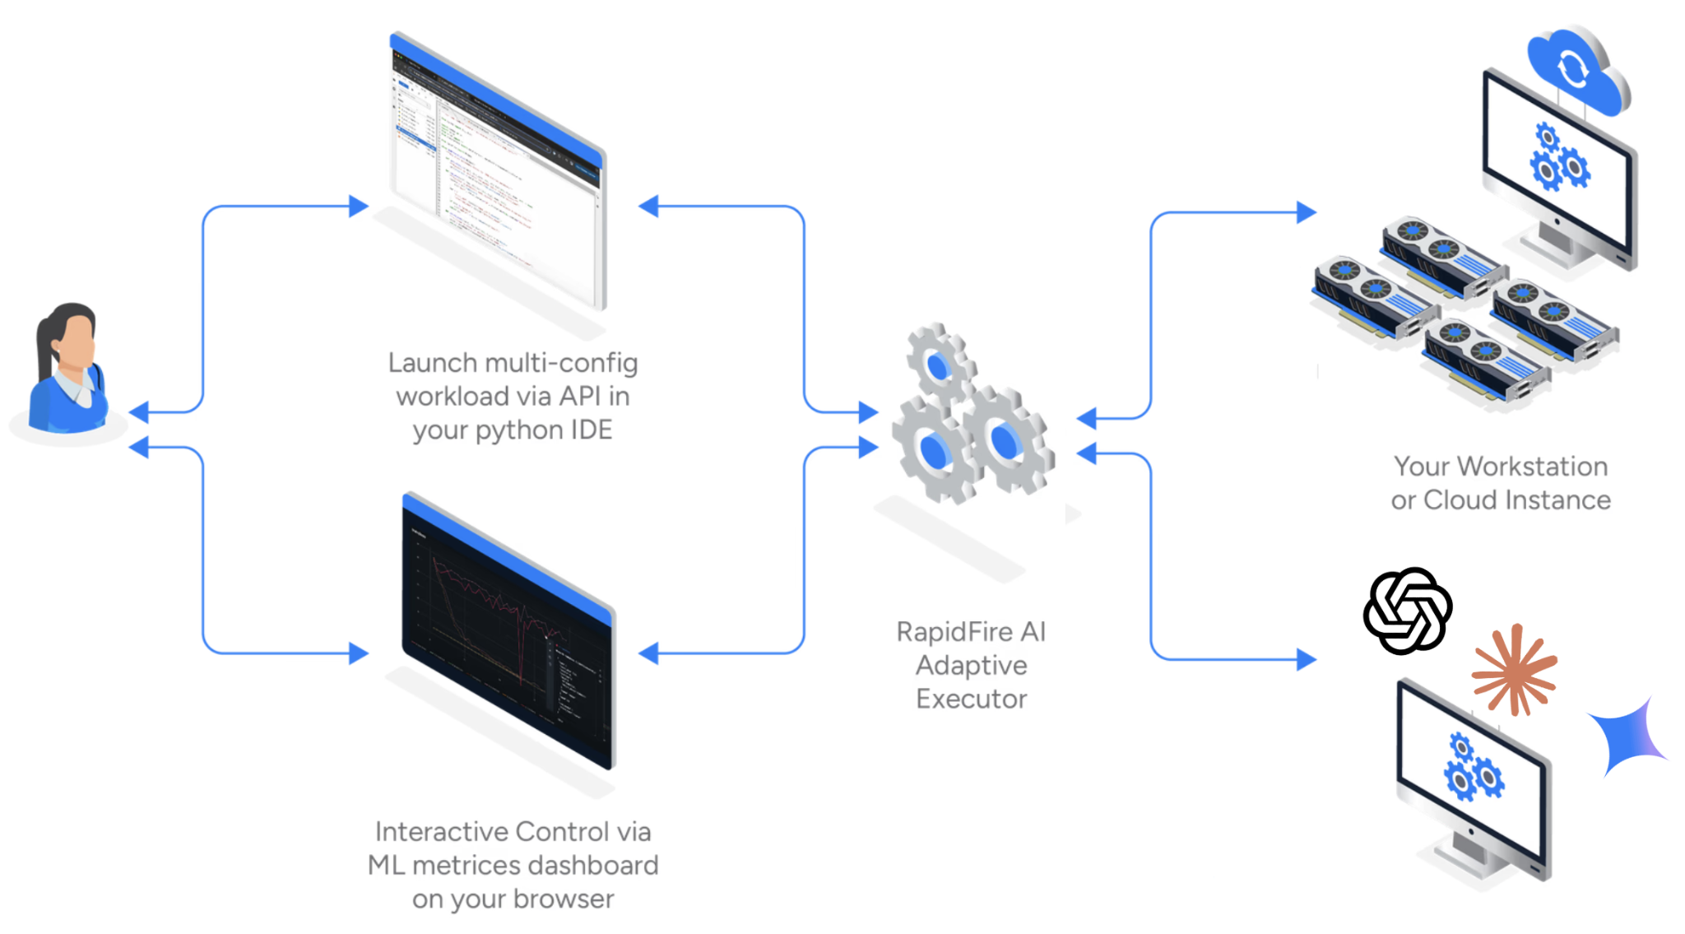
Three-way live system
Your IDE where you launch experiments
RapidFire Metrics dashboard + control UI
Multi-core / multi-GPU execution backend
First-class linkage between editing, observing, and executing runs

Slide 18
How you work with it
Start the server and init evals mode from the CLI or notebook cell
import rapidfireai in notebook or scripts
Define groups of configs to compare; launch them together via the run_evals() API
Metrics appear as plots in the ML dashboard; for RAG/context evals, they also appear in the notebook itself as a table
Interactive Control (IC) Operations: Stop, Resume, Clone-Modify runs in flight

Slide 19
Adaptive execution engine (core idea)
Training/eval data split into random shards (chunks)
Schedules all runs on one shard at a time, then cycles — not full pass before any signal
For self-hosted models: Swap adapters/models across GPU/DRAM with shared-memory caching (can spill to disk)
For closed model APIs: Swaps API calls across configs and automatically apportions token rate limits
Swap overhead often <5% of runtime in reported measurements
Source: https://oss-docs.rapidfire.ai/en/latest/difference.html

Slide 20
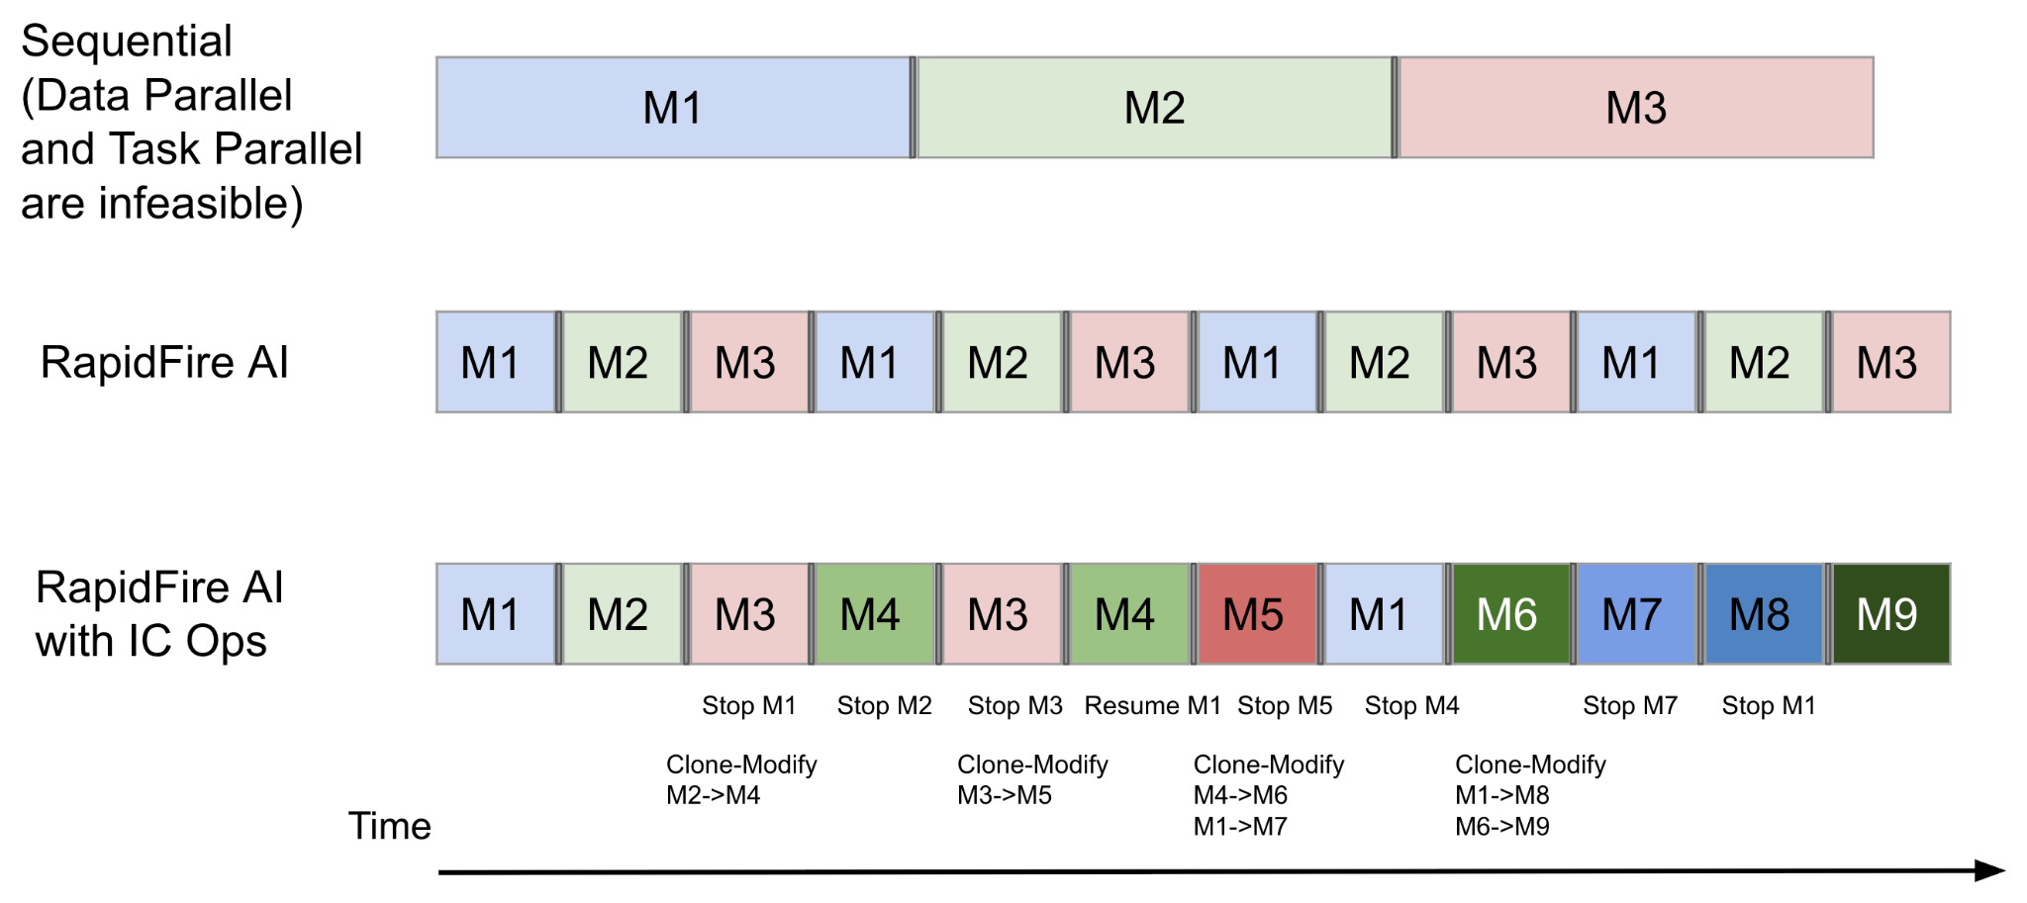
Why sharding vs. sequential
1 GPU, multiple configs: see learning behavior on early shards before sequential run 3 starts
RAG evals: online aggregation — estimated metrics + confidence intervals as shards process
Converges to exact full-dataset metrics when all shards finish

Slide 21
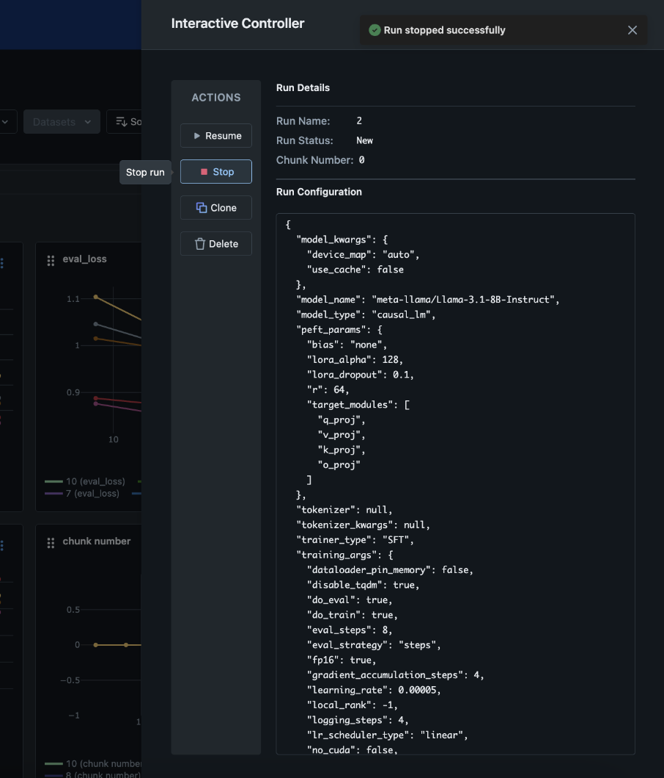
Interactive Control Operations (IC Ops)
Stop unpromising runs (wait queue); resume later
Clone strong runs; modify knobs; warm-start from parent
Scheduler places runs/chunks on GPUs — focus on experiment logic, not low-level parallelization
With IC Ops, explore many more configs in similar wall-clock vs. naive sequential

Slide 22
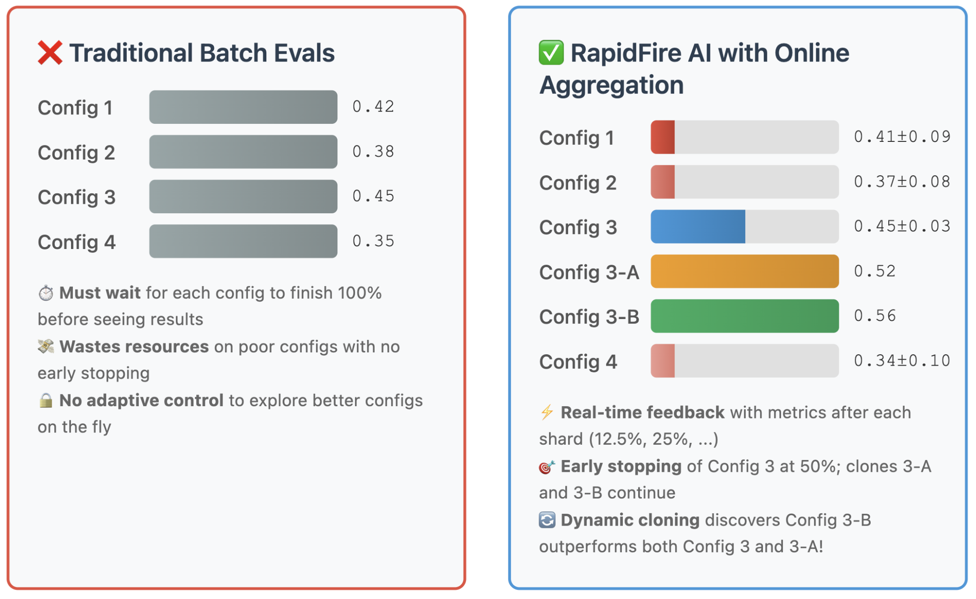
Online aggregation for evals
Classic batch eval: each config must finish the full eval set before you trust its score -> slow and expensive for LLM calls.
RapidFire randomly shards the eval set; configs advance in parallel, shard by shard. You get running estimates plus confidence intervals in real time.
Use that signal with IC Ops: stop weak runs early, clone strong ones, and steer API token spend toward better configs.
Tag metrics as distributive (additive counts/sums) or algebraic (means/proportions from decomposable parts) so aggregation and CIs are statistically sound.

Slide 23
RAG with RapidFire
You describe one RAG pipeline as a single object: RFLangChainRagSpec (standard LangChain pieces: load, chunk, embed, store, retrieve, optional rerank).
You attach that object to a generator config: usually RFOpenAIAPIModelConfig for this class (API model + your RAG spec).
RapidFire runs many such configs in parallel, shows metrics in the notebook, and lets you stop/clone/tweak runs (IC Ops).

Slide 24
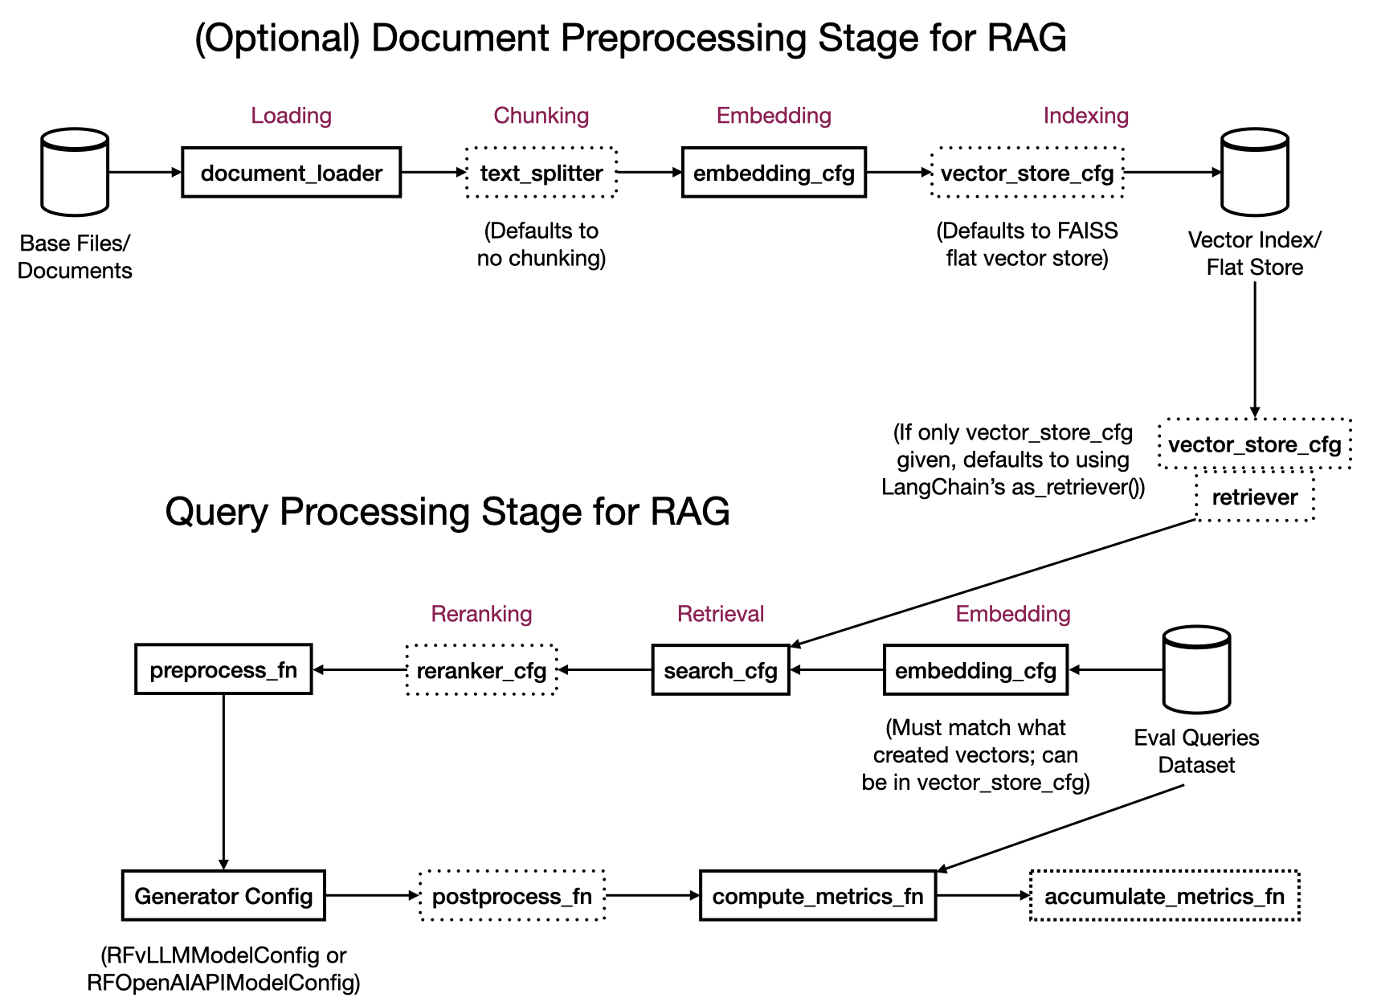
RAG with RapidFire

Slide 25
What to do in practice
Get a baseline working end-to-end first (one chunk size, one embedding, default FAISS, one search top-k).
Turn knobs into experiments: e.g. several chunk sizes or embedding models by passing List(...) on those fields — that is your multi-config sweep.
Only open the full API reference when you need a specific feature (PGVector, custom retriever, reranker, few-shot prompts).

Slide 26
Submission logistics
Submit once per team via Canvas (only the final upload counts if you resubmit).
Single zipped folder named <TeamID>.zip using your assigned team ID.
Keep the course Projects page policies in mind (teams, integrity, git rules).
Git repo expectations
Private repo: add all TAs and the instructor as collaborators within 24 hours of release (GitHub IDs on Piazza).
Commit and push logs regularly — rapidfire.log and metrics files are required evidence for experimentation and partial credit.
History should show real iterative work; dumping AI-generated code in one commit or forging history is an integrity violation.

Slide 27
Evaluation plan
Retrieval evaluation
Provided script scores overlap between retrieved chunks and ground-truth source spans (file + line ranges).
A retrieved chunk counts as a hit if it overlaps any ground-truth span for that question.
Reported retrieval ingredients include F1, Precision@k, and Recall@k for specified k (used in the leaderboard retrieval score).
Generation evaluation
LLM-as-judge on OpenAI; each metric scored 0–5.
Released rubric: Correctness, Completeness, Faithfulness (grounded in retrieved context).
Hidden test adds two additional judge metrics (also 0–5) so teams cannot overfit the public rubric alone.

Slide 28
Thank you!

